Slide 1
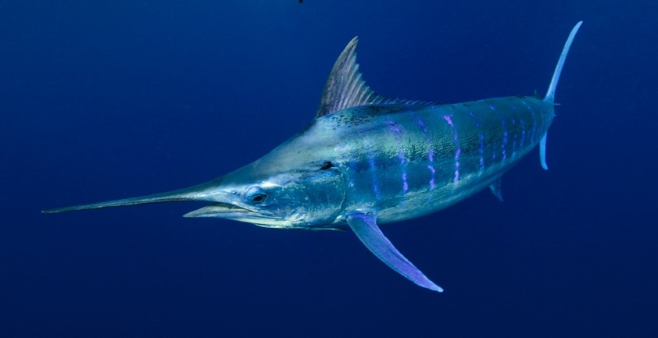
U.S. Commercial Fisheries for Marlins in the North Pacific Ocean
Pacific Islands Fisheries Science Center
Fisheries Research & Monitoring Division
Russell Ito and Michelle Sculley
NOAA Pacific Islands Fisheries Science Center
ISC Billfish Working Group Meeting
November 2-12, 2020

Slide 2
Marlin Catch by Gear Type
Pacific Islands Fisheries Science Center
Fisheries Research & Monitoring Division

Slide 3
Marlin Catch by Species
Pacific Islands Fisheries Science Center
Fisheries Research & Monitoring Division

Slide 4
Striped Marlin Catch by Gear Type
Pacific Islands Fisheries Science Center
Fisheries Research & Monitoring Division

Slide 5
Pacific Islands Fisheries Science Center
Fisheries Research & Monitoring Division
Blue Marlin Catch by Gear Type

Slide 6
Pacific Islands Fisheries Science Center
Fisheries Research & Monitoring Division
Number of Hawaii-based Longline Vessels

Slide 7
Pacific Islands Fisheries Science Center
Fisheries Research & Monitoring Division
Hawaii-based Longline Catch of Marlins

Slide 8
Pacific Islands Fisheries Science Center
Fisheries Research & Monitoring Division
Hawaii-based Longline Marlin Catch by Area, 2019

Slide 9
Hawaii-based Deep-set Longline Striped Marlin and Blue Marlin CPUE
Pacific Islands Fisheries Science Center
Fisheries Research & Monitoring Division

Slide 10
Number of U.S. Commercial Troll Fishers
Pacific Islands Fisheries Science Center
Fisheries Research & Monitoring Division

Slide 11
U.S. Commercial Troll Catch of Marlins
Pacific Islands Fisheries Science Center
Fisheries Research & Monitoring Division

Slide 12
Hawaii Troll Striped and Blue Marlin CPUE
Pacific Islands Fisheries Science Center
Fisheries Research & Monitoring Division

Slide 13
Number of Hawaii Handline Fishers
Pacific Islands Fisheries Science Center
Fisheries Research & Monitoring Division

Slide 14
Hawaii Handline Marlin Catch
Pacific Islands Fisheries Science Center
Fisheries Research & Monitoring Division
99%
95%

Slide 15
Weight-frequency Histograms of Striped Marlin and Blue Marlin, 2019
Pacific Islands Fisheries Science Center
Fisheries Research & Monitoring Division
Longline Fishery
Troll and Handline Fisheries

Slide 16
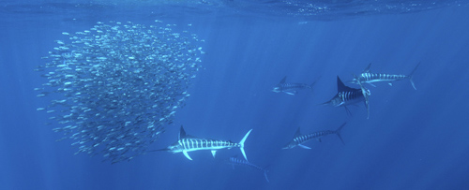
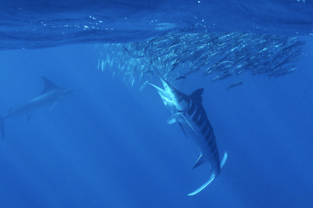
Overview of U.S. Commercial Fisheries for Marlins in the North Pacific Ocean
Pacific Islands Fisheries Science Center
Fisheries Research & Monitoring Division
*Blue and striped marlins are the largest components of the U.S. commercial fisheries marlin catch
*Longline fishery is the largest commercial fishery for marlins
*CPUE for striped and blue marlin declined from early 1990s & remain relatively low
*Striped marlin caught mainly by the longline fishery
*Blue marlin caught by both the troll and longline fishery
*Marlin size distribution similar for both longline and troll fisheries

Slide 17
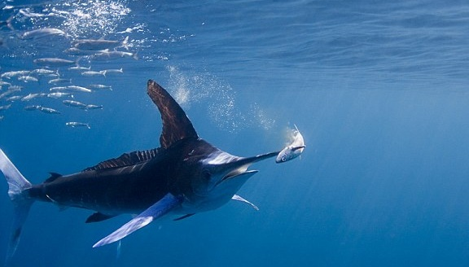
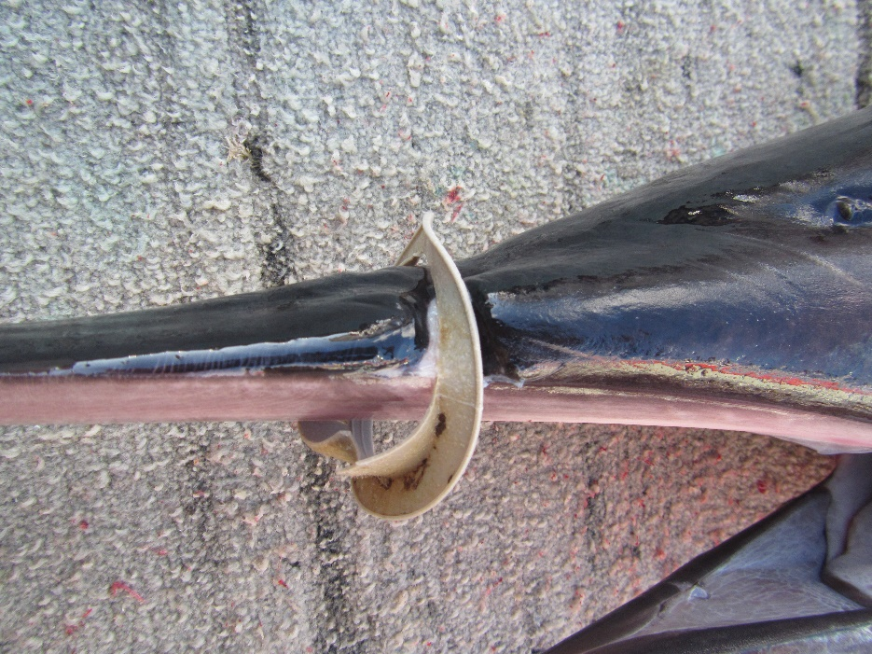
Recent Developments
Pacific Islands Fisheries Science Center
Fisheries Research & Monitoring Division
*Effects of Covid-19 on fishing activity & fish market
*Reopening the false killer whale Southern Exclusion Zone

Slide 18
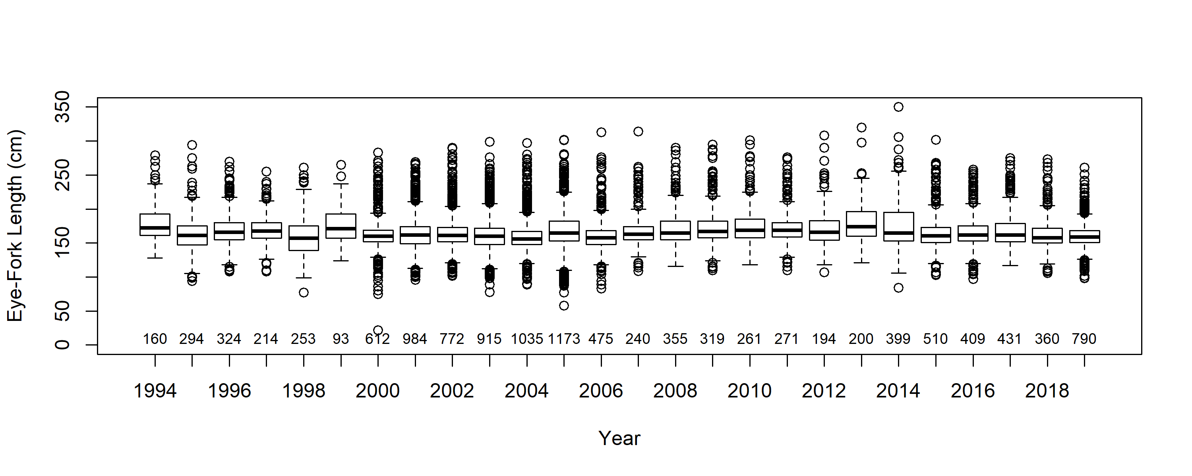
Annual Mean length from PIROP data

Slide 19
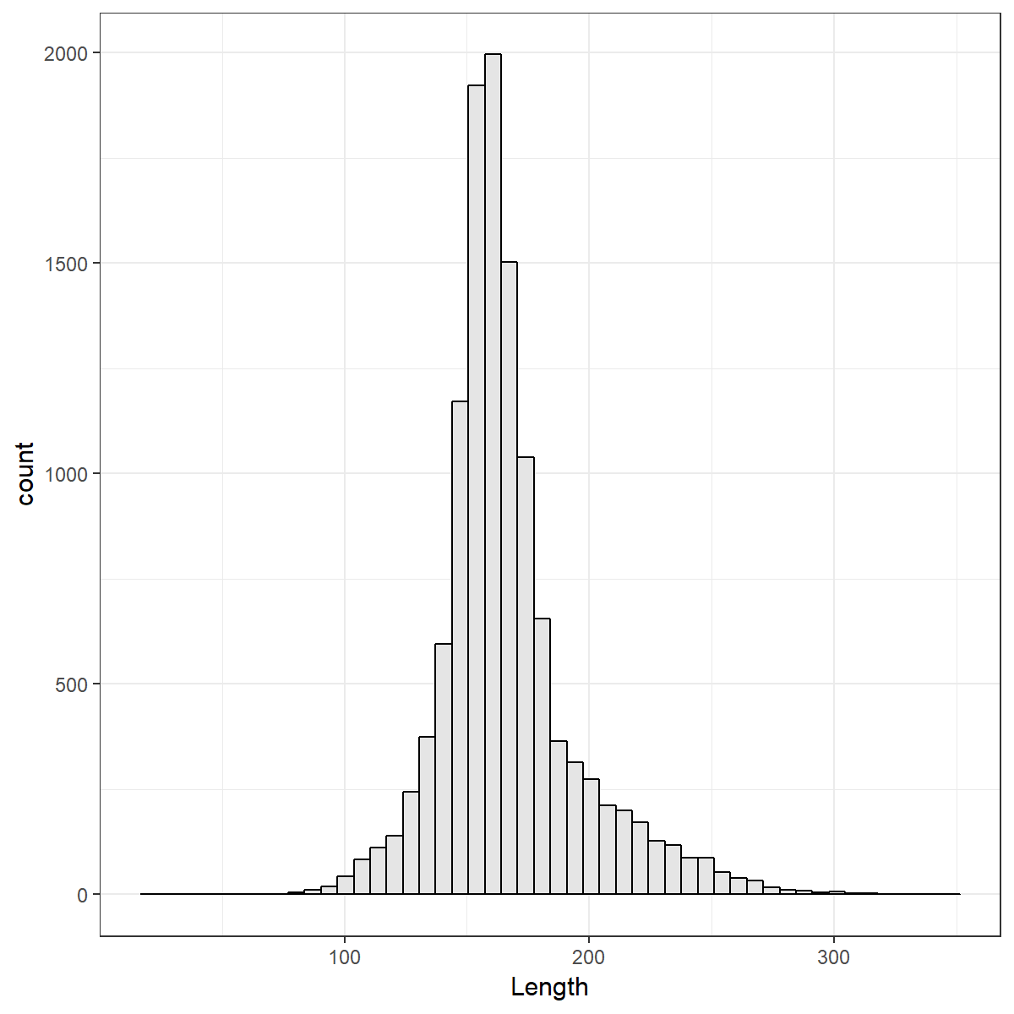
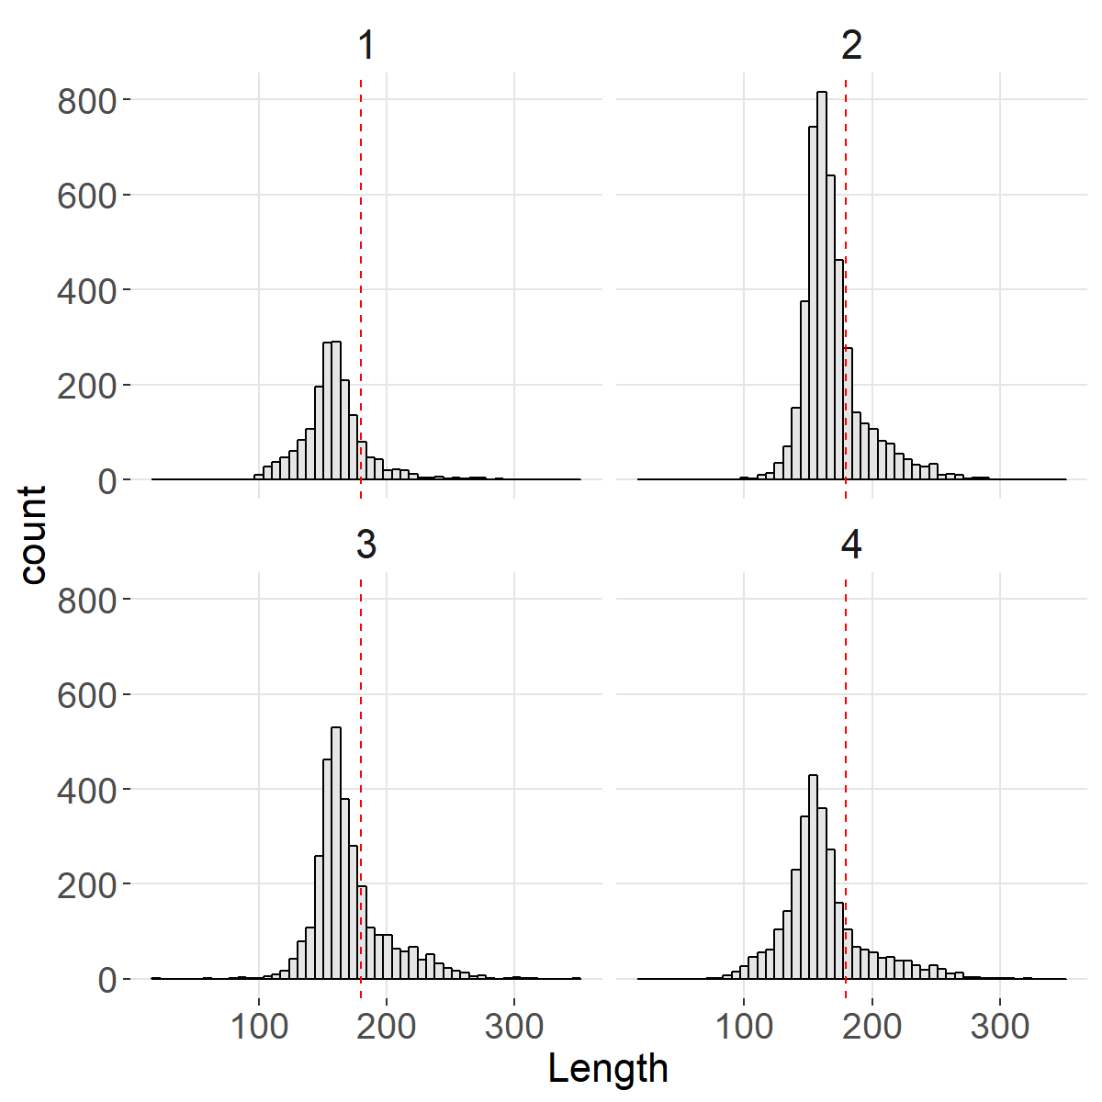
Histogram of lengths overall and by quarter

Slide 20
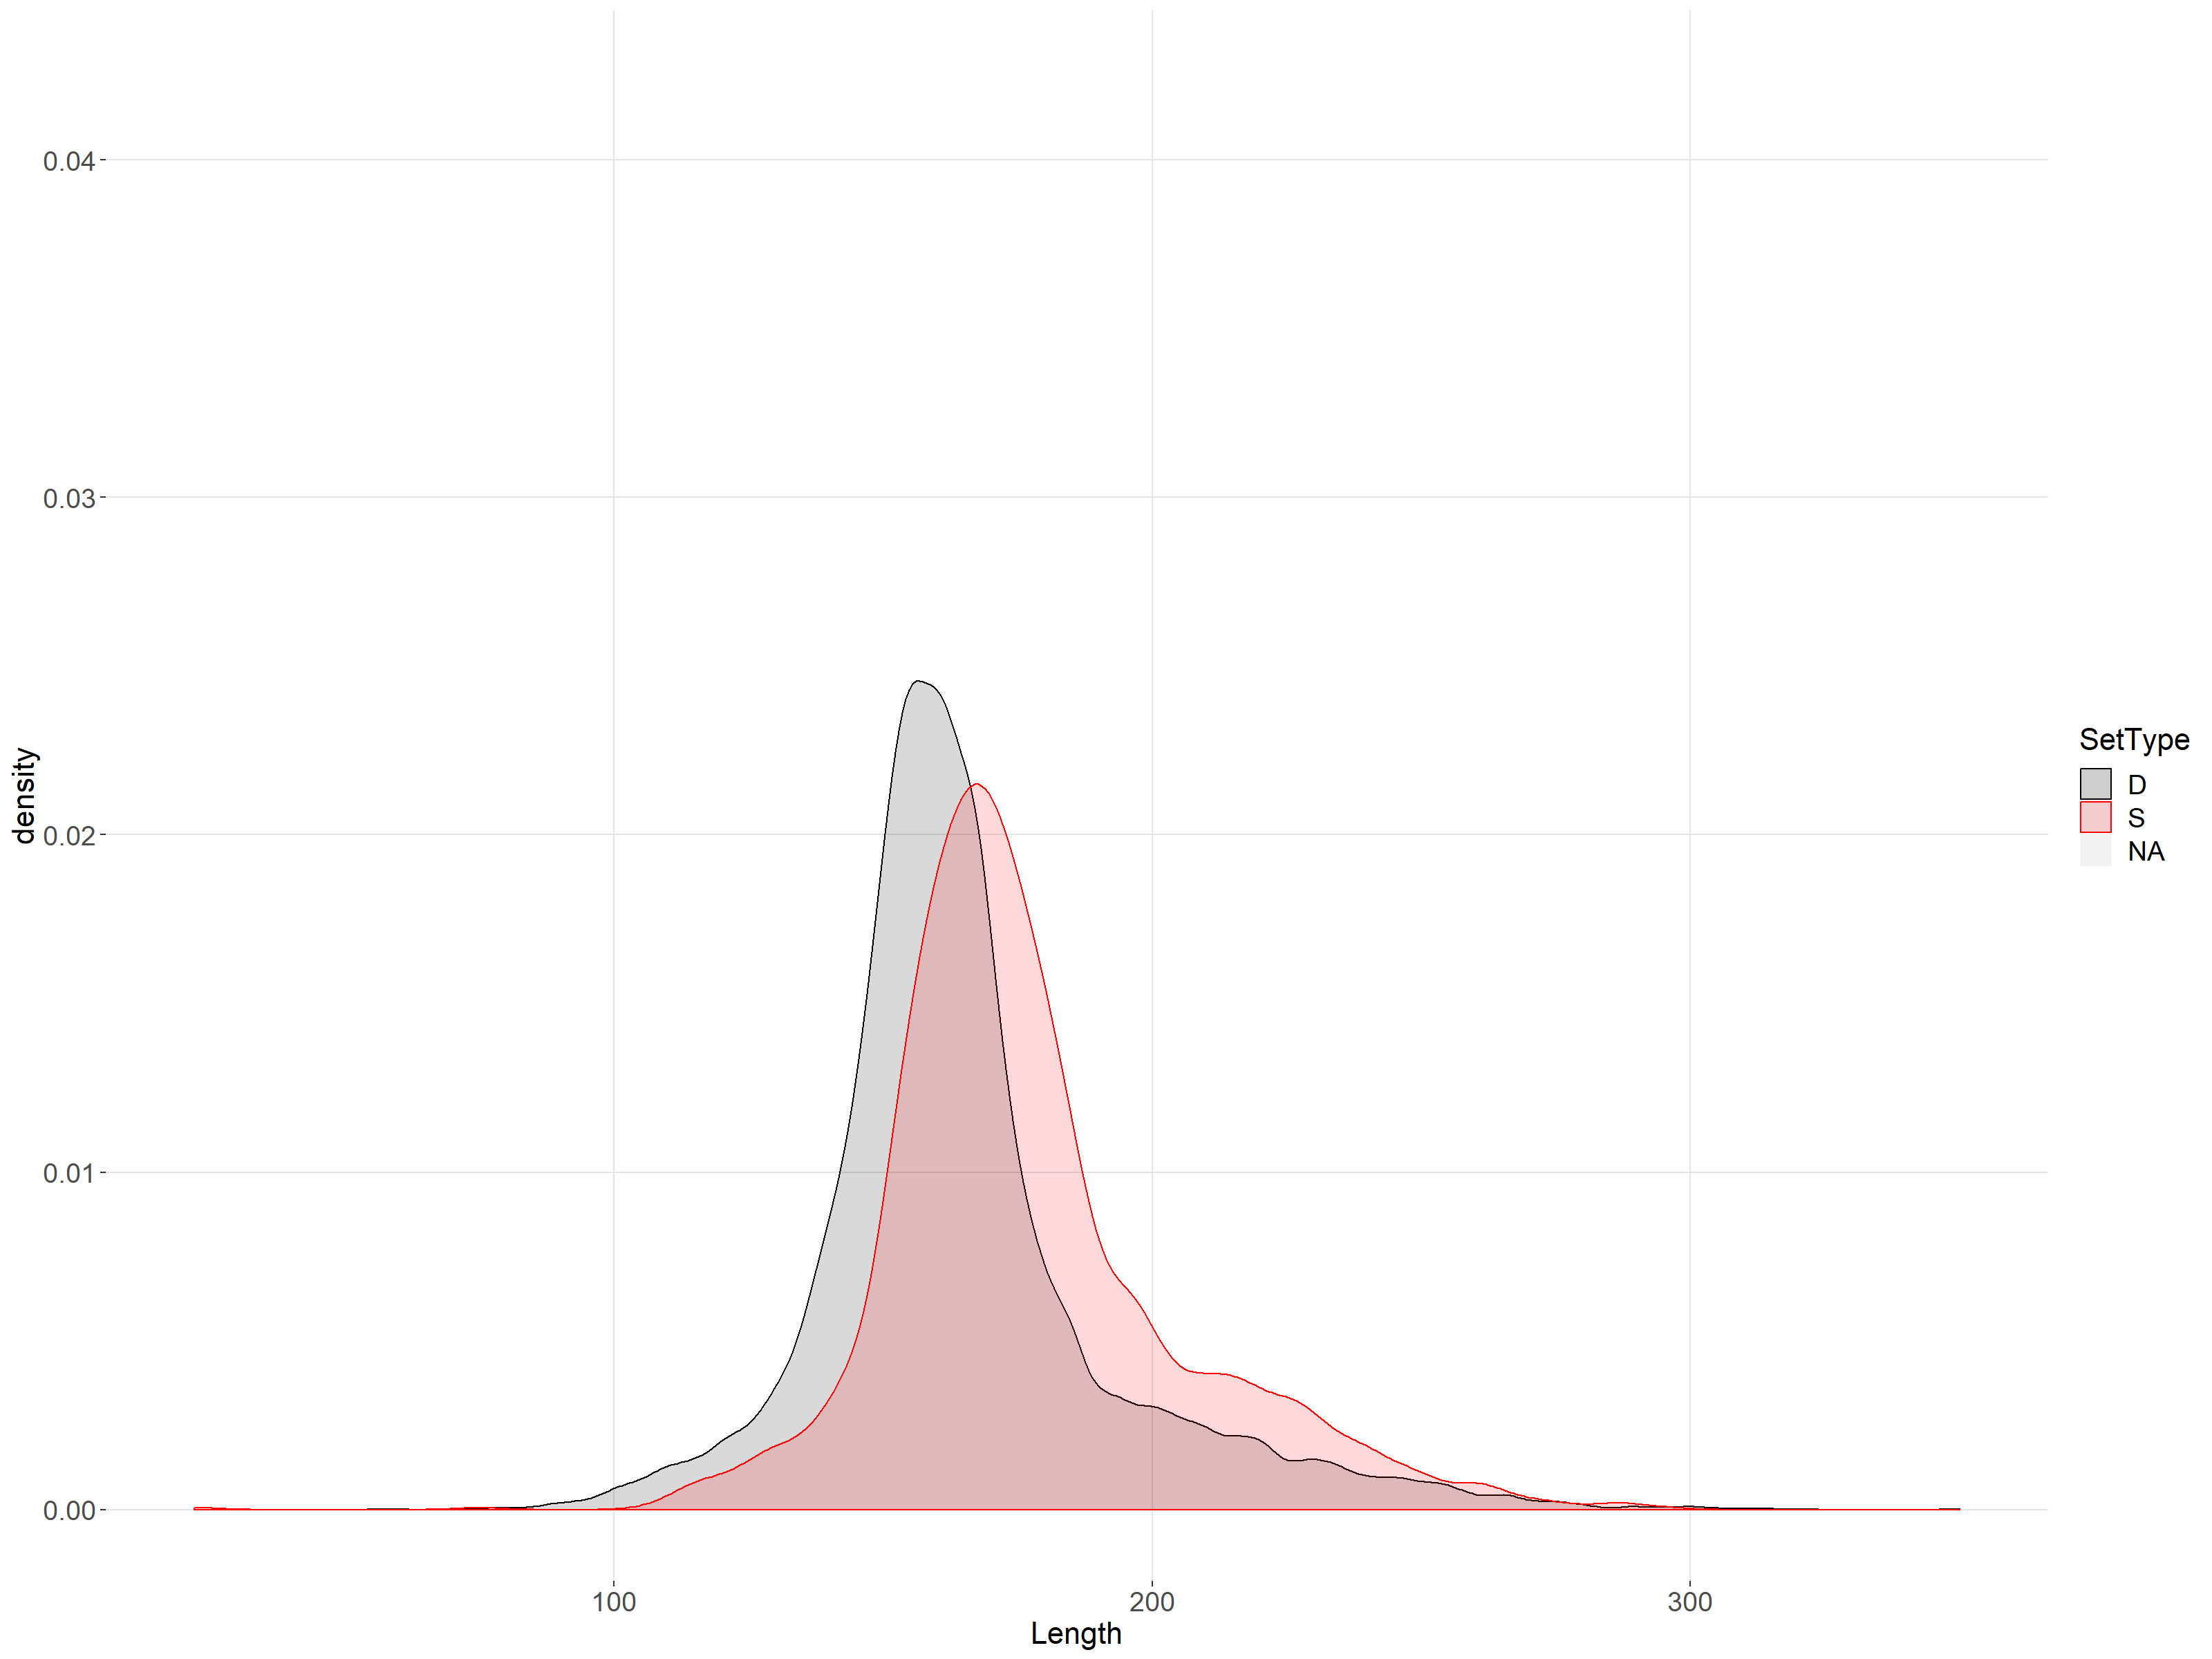
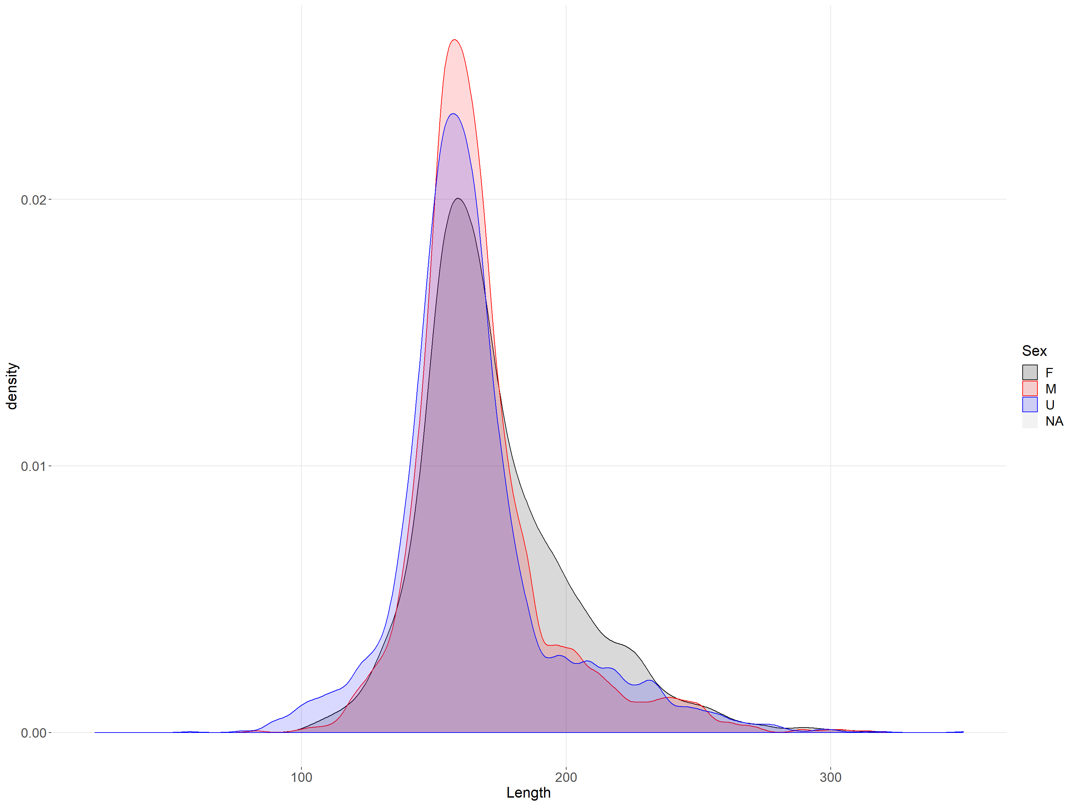
Density of lengths by:
Set (deep vs shallow)
Sex (female, male, unknown)

Slide 21
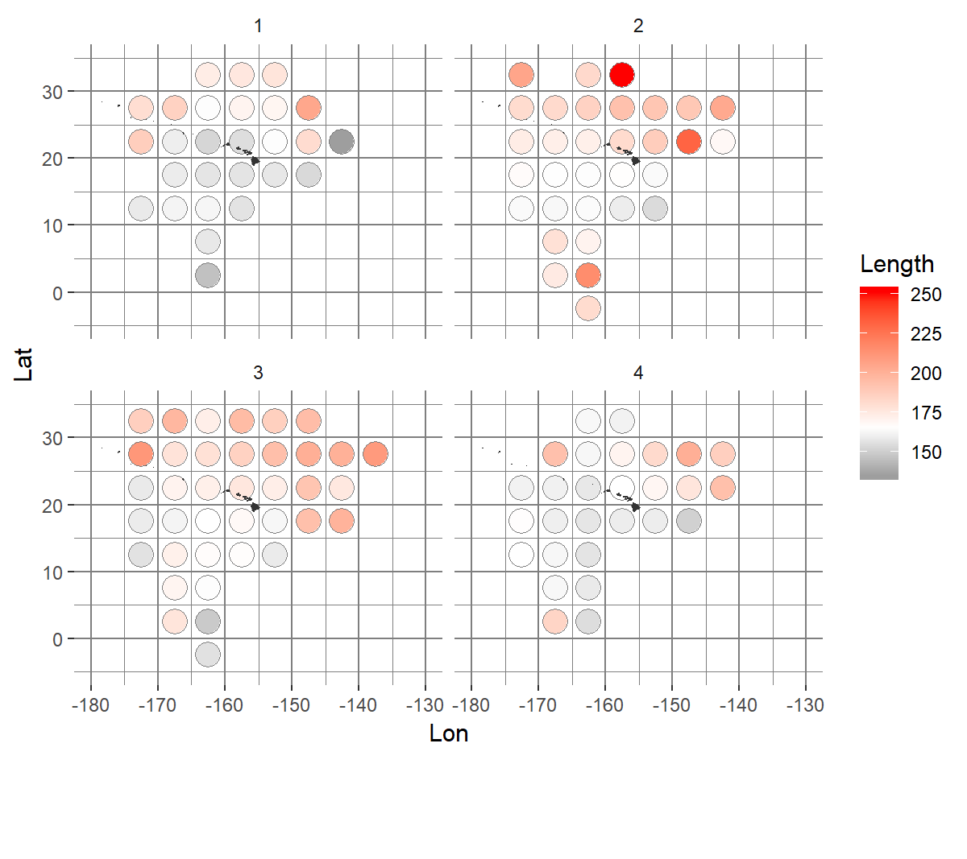
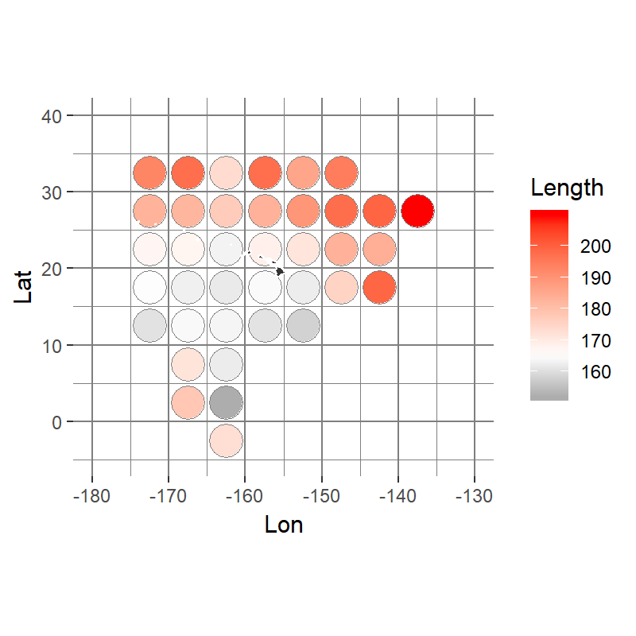
Spatial distribution of mean length overall and by quarter

Slide 22
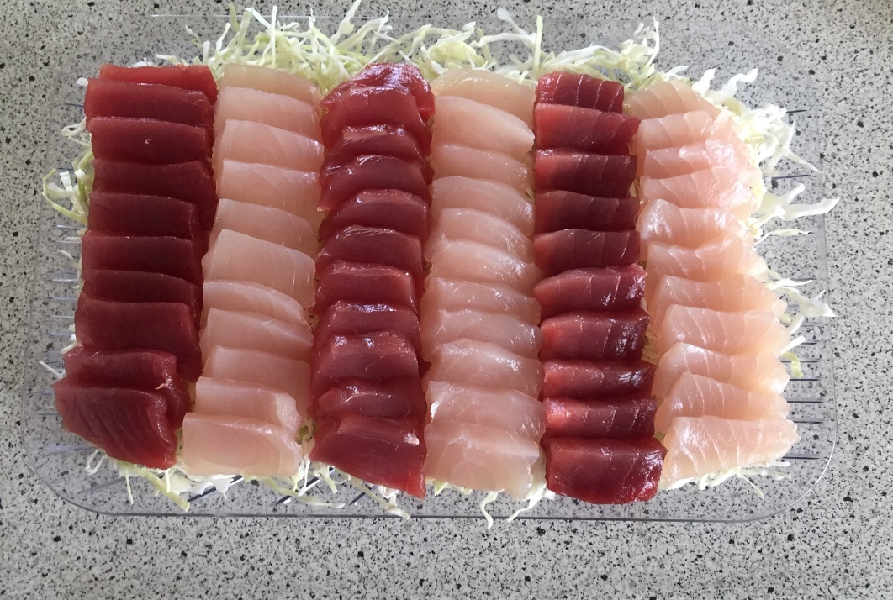
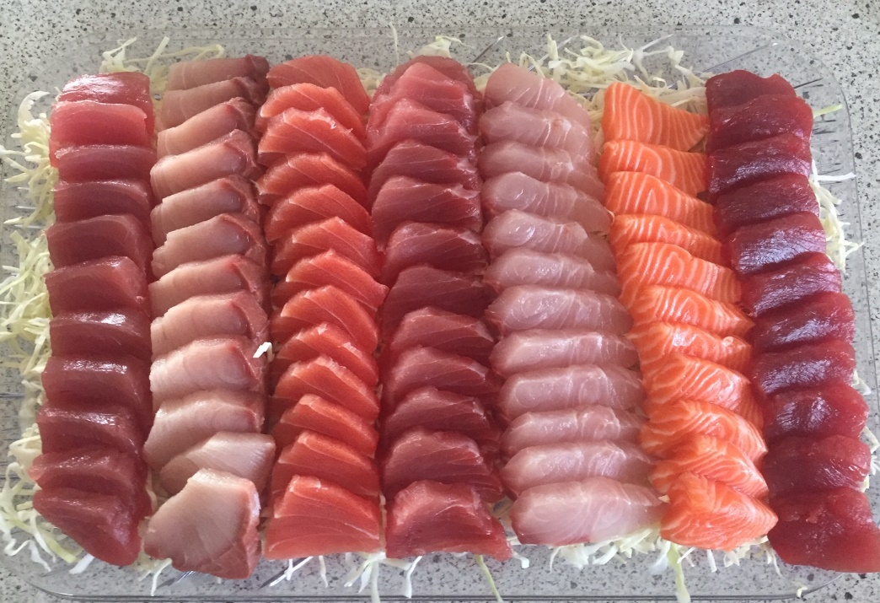
Acknowledgements
Pacific Islands Fisheries Science Center
Fisheries Research & Monitoring Division
Fishery Monitoring Branch personnel Walter Machado & Emeline Kalahiki
International Fisheries Program- Ashley Tomita, and Keith Bigelow
Data managers & keypunchers Chris Tokita and Nate Chan
PIRO Observer Program

